Slide 1
Non Functional Requirements

Slide 2
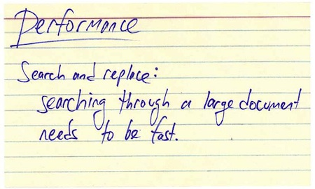
Knowing of non-functional requirements
Helps to avoid of customers say
„You should thing better!“

Slide 3
It helps a lot if you know what is the “most critical“
non-functional requirement because this can dominate
the best choice of development technique
and internal design.

Slide 4
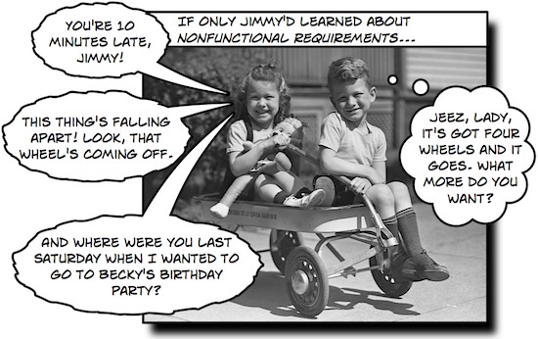

Slide 5
Non-functional requirements are aspects
Users have implicit expectations about how well the software will work.
These characteristics include
  how easy the software is to use,
  how quickly it executes,
  how reliable it is,
  and how well it behaves when unexpected conditions arise.
The non-functional requirements define these aspects about the system.

Slide 6
Non Fuctional Requirements - General
Security
Exception Handling
Validation
Logging
Tracing / Testing
Monitoring / Reliability
Transaction
Storage
GUI Binding
Configuration

Slide 7
Non Fuctional Requirements– System / Dev
Naming conventions
Caching, Performance
Scalability
RAM usage
Thread Sync

Slide 8
Non Fuctional Requirements - Business
Time to market
Cost
Speed / Performance
Interoperability
Flexibility
Disaster recovery
Usability
Accessibility

Slide 9
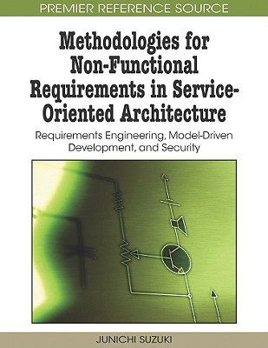
How to fetch non-functional requirements?
Anti-stories are things the user does not want to happen, commonly for safety or security reasons.
  No way we let an ILOVEYOU EMail worm in our System!
Use a checklist ☺

Slide 10
Security
Should access to be limited?
Is an access list necessary?
  Access Control List
  White List
  Black List

Slide 11
Exception handling
What errors can occur on runtime?
What it should do in case of error?

Slide 12
Validation
Which input items are required?
Which of them need to be validated?
What to do if input is invalid?
How to recognize if an item is valid? (email, personal number, ZIP code...)
Be aware - customer tends to change it frequently!

Slide 13
Logging
It is about loggin from the user perspective, not developer’s logging
Which events should be logged?
Which items should log contain?
Is the last operation enough or you need history?
  How deep the history should be?
Where to log? (file/db/…)
Who should have access to logs?
Incremental or rotation log?
How to purge/delete logs?

Slide 14
Tracing - testing
How to test an application?
Which parts of the application should traceable?

Slide 15
Monitoring - SLA
How it will be monitored?
Are there any special monitoring rules?
Use cases will help you best:
  How to watch each particular use case?
  What to watch/track there? (user/action/result)

Slide 16
Transaction
Which operation is „atomic“- what must be proceeded all at once?
How to do rollback/cancel an operation?

Slide 17
Naming conventions
Name of a product/service and internal naming (Windows Chicago vs. Windows 2000)
Establish internal naming conventions – it will help you to avoid of troubles
  in case of unclear product name
  in case of change the public product name

Slide 18
Caching, performance
Think about scalability
What to cache
What must be strictly online
  Prepare fallback scenario in case of outage

Slide 19
Sources
http://en.wikipedia.org/wiki/Non-functional_requirement
http://broadcast.oreilly.com/2010/02/nonfunctional-requirements-how.html
http://www.stellman-greene.com/2010/02/17/nonfunctional-requirements-qa/

